Slide 1
Our Transition Mission
Collaborations for College Success
OELMA Conference
October 21, 2010
Ken Burhanna, Kent State University
Deidra Herring, Ohio State University
Jillian Maruskin, Ohio Wesleyan University
Patricia Owen, Eastwood Local Schools
Laura Piazza, Upper Arlington High School
Jennifer Schwelik, WVIZ/PBS ideastream
Ann Marie Smeraldi, Cleveland State University
Beth Tumbleson, Miami University – Middletown

Slide 2
Topical Outline
INFOhio – J. Schwelik
TRAILS – J. Schwelik
Informed Transition at Kent State – K. Burhanna
Transitioning to College – K. Burhanna
Info Lit Skills Check List for Students – P. Owen
Eastwood High School’s 12 – 13 Experiences – P. Owen
12 -13 at Miami University Middletown – B. Tumbleson
12 – 13 at Cleveland State University – A.M. Smeraldi
OSU and the P20 Mission – D. Herring & L. Piazza
Educating Pre-Service Teachers – J. Maruskin

Slide 3

^{INFOhio’s Go Further!}
Road to Higher Education and Beyond Campaign
Schwelik

Slide 4
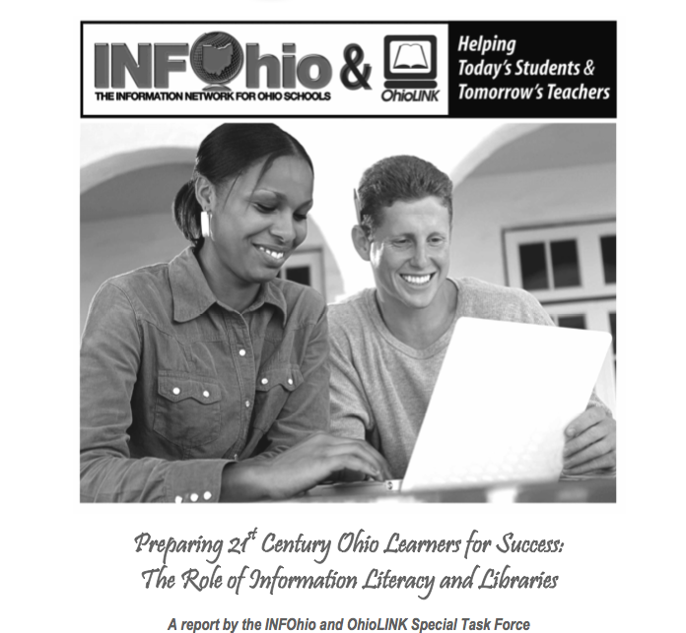
12-13 Transition Special Task Force Project
White Paper
Schwelik
Notes:
4
Developing 21st Century Skills
Incorporate Research Experience
Deliver Research Resources
Prepare Student Teachers
Partner with Groups Statewide
Enable Collaboration

Slide 5
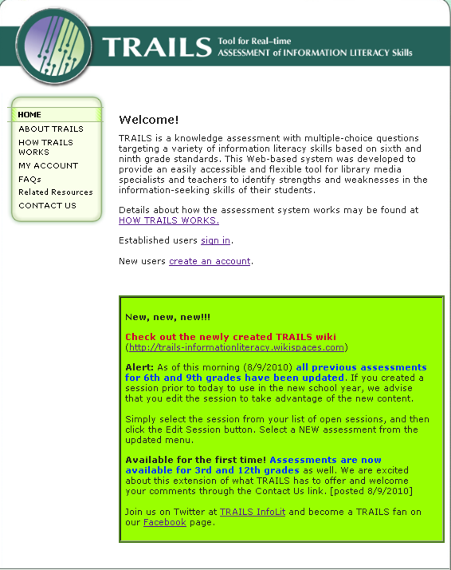
Information Literacy Assessment
Grades
3, 6, 9, 12
Pre-test
Post-test
Category Tests
Notes:
The great news is that TRAILS can help answer the questions about how well your students use information.
TRAILS offers free assessments that will allow you to determine the information literacy skills of each student. You will then be able to provide the appropriate instruction to insure that each is ready for their future.
The objective tests are aligned with AASL and Ohio standards. Once students complete the test, you have immediate access to their results. Tests are available for grades 3,6,9,and 12. There are pre and post tests for each grade level as well as category tests. Develop topic, identify potential sources, Develop use and revise search strategies. Evaluate sources. 5. Recognize how to use information responsibly, ethically, and legally
5

Slide 6








Create an account: http://www.trails-9.org/
Notes:
6
Please visit the TRAILS website and set up a free account today! Visit TRAILS on twitter, facebook and Linked-in

Slide 7
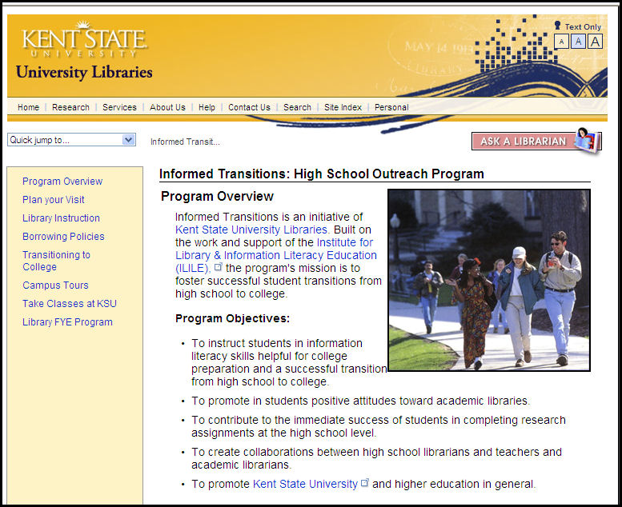
Informed Transitions
www.library.kent.edu/highschool
Burhanna

Slide 8
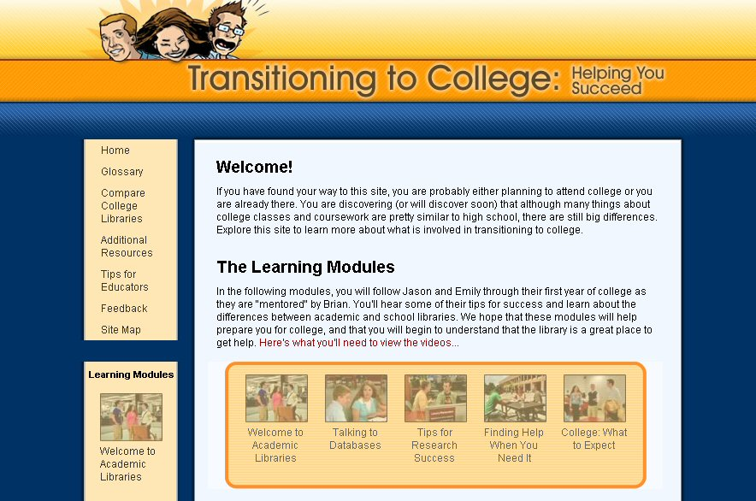
Transitioning to College -- T2C
www.transitioning2college.org
Burhanna

Slide 9
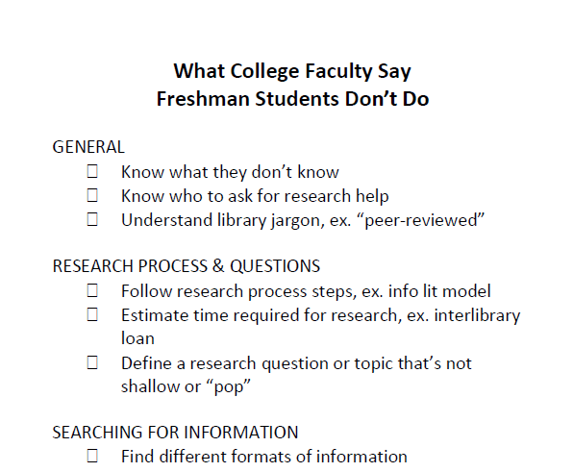
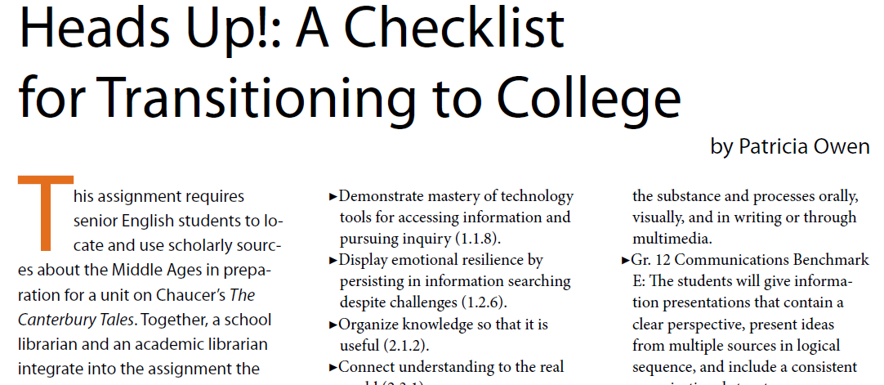
At EHS we have confronted the challenge of preparing our seniors for college using 4 basic tools:
1) collaboration with and visits from academic librarians
2) integration of info lit skills into senior English assignments
3) a checklist of skills
students need for
college
4) TRAILS for assessment.

Slide 10
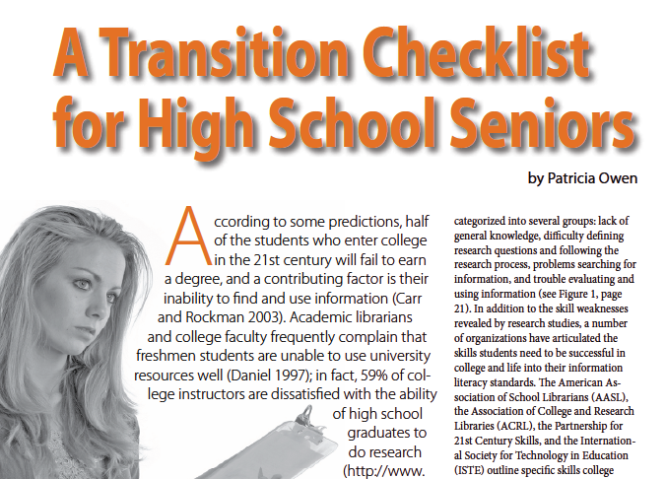
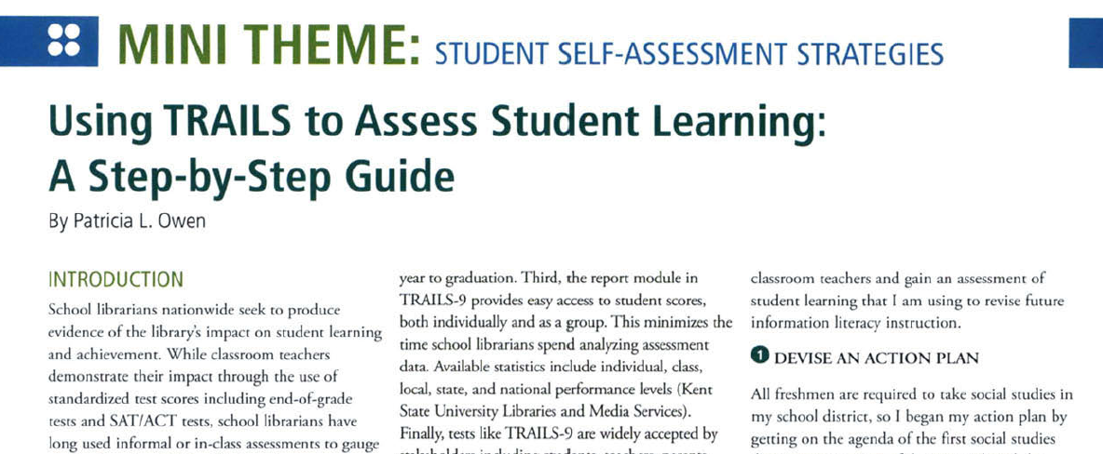
The story of what I did at EHS is spelled out in detail in the articles I've published which are all linked on my site (infowen.info) and in the INFOhio databases and hopefully you picked them up as you came in.
You also picked up a bookmark that contains the checklist skills our students strive to acquire their senior year before they pack their bags for college.

Slide 11
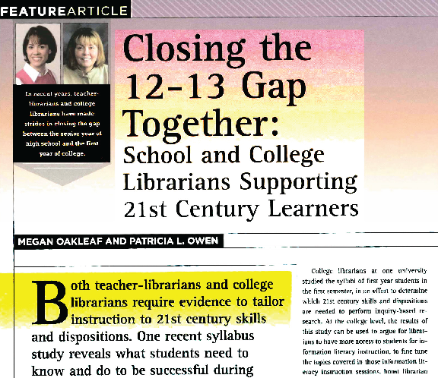
The article co-authored with an academic librarian was the basis for deciding which skills seniors need to succeed in college and evolved into the 12-13 skills listed on the bookmarks you're holding.
I'm happy to answer questions/chat with any of you about my experiences now or after this session.

Slide 12
Top University Information Literacy Strategies Requested – Miami Middletown
University Libraries & Statewide Library Consortium
Accessing Electronic Catalogs & Collections
Citing Sources & Preventing Plagiarism (Tools & RefWorks)
Big Picture, Context, Background Information
Narrowing Topics
Single Research Question
Search Terms: Keyword v. Subject
Evaluating Sources: Websites
Scholarly Sources: Peer-Reviewed Journals
Literature Search (Database Searching)
Annotated Bibliography
Tumbleson

Slide 13
Information Literacy & HS Students
The University & the Student, 1 Credit
Effective Use of Libraries, 2 Credits
  Cover Basic Technology and Information Literacy Skills
  Use TRAILS
One-Shot Information Literacy Sessions
  Faculty Request Course Research Instruction
Blackboard Embedded Librarian
  Collaborate with Instructor in Learning Management System
  Customize Library Resources & Services to Research Assignments
Reference – Drop-In and Research Consultations by Appointment
Tumbleson

Slide 14
High School Students Access
University Libraries
University Library Research Days
  Receive info lit instruction & access collections
  Letters of invitation sent to local HS principals/librarians, Sept. 2010
Community Borrower’s Card
  HS students eligible with parent’s signature
Post Secondary Education Option Students
  150 enrolled, access library, & earn college credit
Dual-Enrollment Students
  HS students taking MUM courses @ their HS
  Access to university library collections problematic
Prospective Students Tour Campus
  Promote library resources & services @ Miami University & OhioLINK
Tumbleson

Slide 15
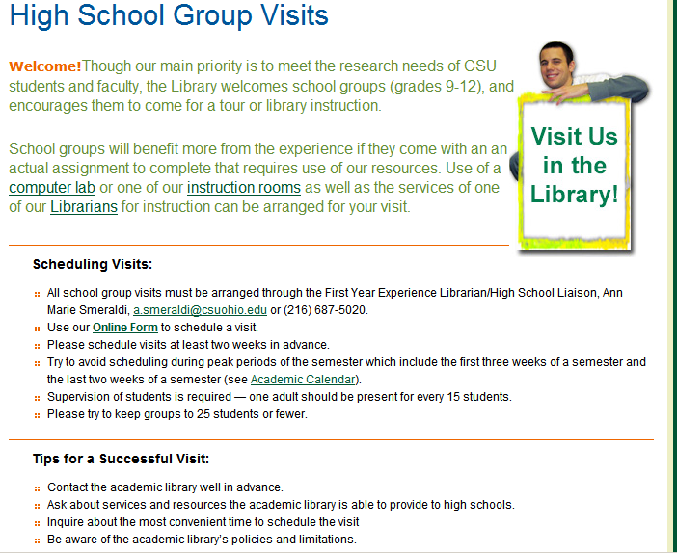
Cleveland State
Outreach to High Schools
High School Liaison Librarian
Tours
Academic Library Experience
Information Literacy Instruction
On-campus access to databases
Borrowing privileges
Smeraldi

Slide 16
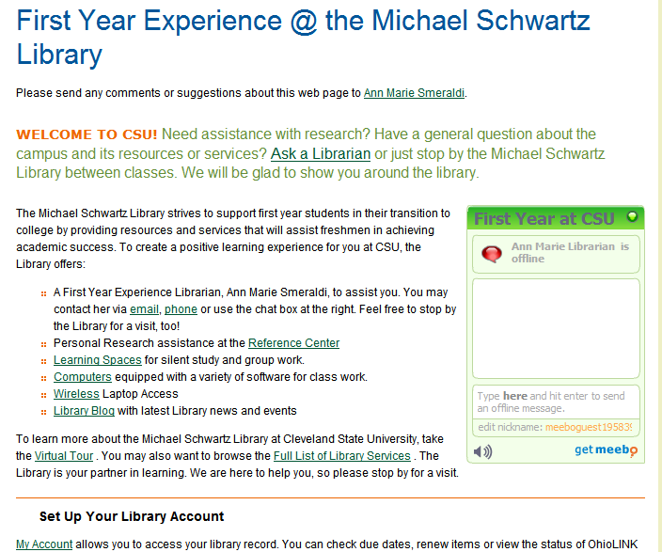
Cleveland State
First Year Students
Intro to University Life Course
  One –Shot Library Session
  Active Learning
College Composition II (ENG 102)
  Incorporates ACRL Standards:
      Identify information need
      Access information
      Evaluate information
      Synthesize information
      Use information for a purpose
      Use information ethically and legally
Smeraldi

Slide 17

The Ohio State University Libraries & P-12 Mission library.osu.edu
Support the OSU P-12 Project and School Partnership Initiative http://p12.osu.edu/resources.php#schoolpartnerships
15 OSU Libraries provide support for affiliated and non affiliated users
Metro Early H.S. & Upper Arlington H.S.- International Baccalaureate Program with Laura Piazza, UA Librarian
Over 50 Subject Specialists for various areas
Herring & Piazza

Slide 18
What Should You Do…?
Contact Us….
Through the web at http://library.osu.edu/find/librarians/
Specific Subject Specialist (pamphlet)
Contact Deidra Herring, herring.44@osu.edu
Outreach Liaison and Education Subject Specialist via email or phone
PLEASE plan in advance! (library tours, orientation on or off-campus)
Herring & Piazza

Slide 19
Key Things to Keep in Mind…
Provide clear objectives through a lesson plan based on your needs
Provide the librarian with number of students (room reservations)
Understand the complexity of campus parking
Access to computers (login’s must be arranged ahead of time)
A Visitor’s BuckID card is needed for Copying and Printing materials
Partnerships grow through clear collaboration and opportunities!
Herring & Piazza

Slide 20
Incorporating 21st Century Skills Into the Curriculum
Workshop given at Ohio Wesleyan University to graduating pre-service teachers.
Workshop Agenda:
Intro to 21st Century Skills
INFOhio (resources, Research Project Calculator,
21 Essential Things)
Practical examples
Discussion of students’ assignment
Maruskin

Slide 21
Purpose of Workshop:
To make pre-service teachers aware that librarians are there to help them.
To show them the resources needed to responsibly and effectively integrate technology and research skills into their daily curriculum.
To promote INFOhio.
Maruskin

Slide 22
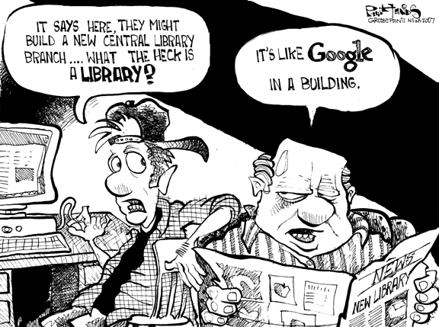
What’s on your mind?

