Slide 1
Copy Cataloging Made (Even) Easier
Richard Wisneski
OVGTSL Conference
May 2014

Slide 2
Preliminaries
Kelvin Smith Library works primarily with Ingram/Coutts
Cataloging services are through SkyRiver
Integrated Library System is Innovative
Bib, Item, and Order records are loaded when purchases first sent via Edifact, with Estimated Prices.
Records are later overlaid when material is received

Slide 3
Invoices
Received, in descending order by Invoice number (checked by catalogers)
Order records brought up in Millennium. Item record numbers associated with first and last are copied, then pasted into an ITEM list
See Invoice example
i45084294 --> relates to o6600451, the first order record on first invoice
i45084567 --> relates to .o6601558, the last order record on the last invoice

Slide 4
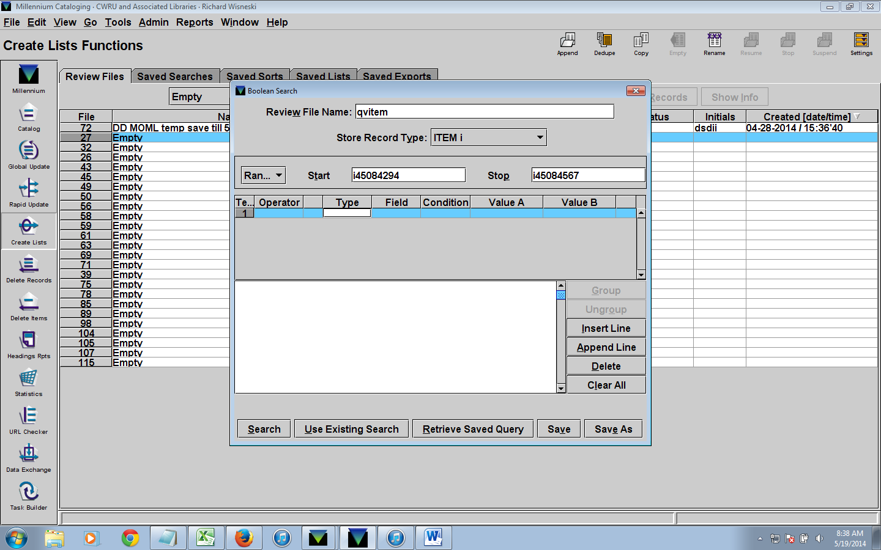
Item List
Note the START item record number and STOP item record number

Slide 5
Item List
Show Records tab
De-select first check box
Compare to invoice – make sure there is nothing missing or erroneously inserted
Sort records – by BIB MARC 050 (to more easily identify missing LC call numbers later on)

Slide 6
Bibliographic List
Create a new list in Millennium
Change “Range to “Review”
Select Item List previously created
Click SEARCH (ignore warning that may come up)
Sort records – by BIB MARC 050 (to more easily identify missing LC call numbers later on)

Slide 7
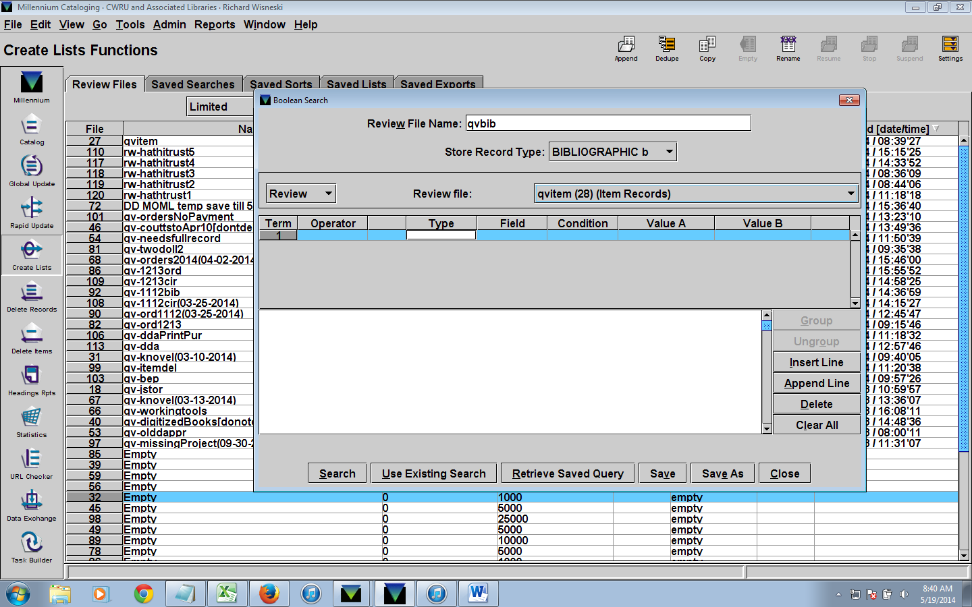
Bibliographic List

Slide 8
Order List
Create a new list in Millennium
Change “Range to “Review”
Select Bibliographic List previously created
Click SEARCH (ignore warning that may come up)

Slide 9
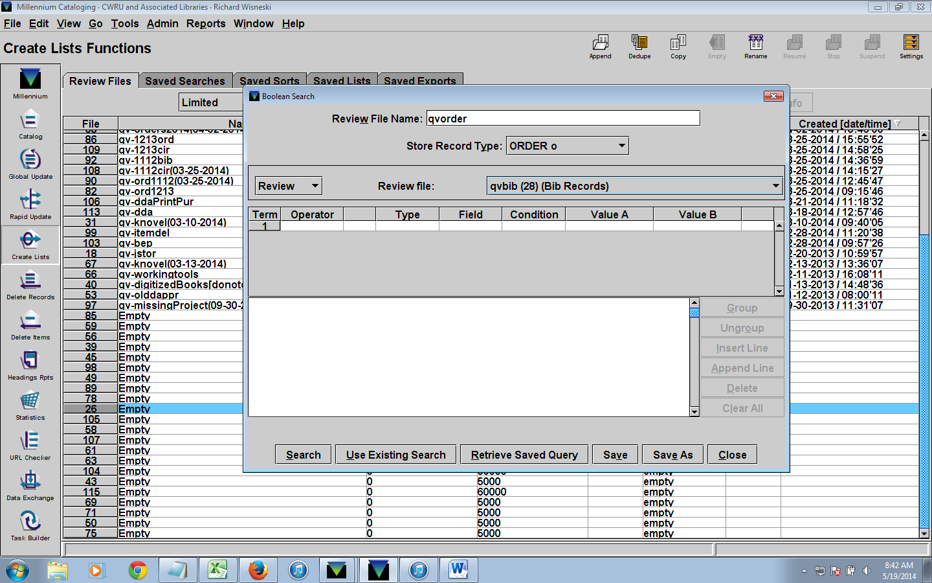
Order List

Slide 10
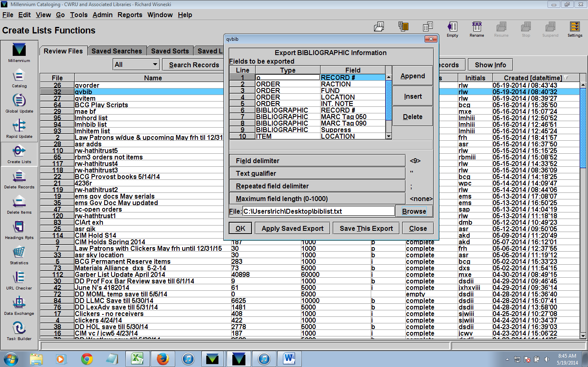
MS Excel Work
Export from the BIBLIOGRAPHIC List
I’ve created a saved export that catalogers/students use for the export

Slide 11
More Excel Work
Identify records with missing Call Numbers. Pull these and place on shelf for copy-catalogers.
If copy-catalogers cannot find LC records, they pass item off to professional cataloger
For those with missing call numbers, pull up record from ITEM list, and delete the item record (since copy-catalogers will later use 949 field to bring in an ITEM record)
For those with a note that says, for example “add to .b#”, or “notify NAME,” pull these and put on shelf for copy-cataloger. Also, remove these from the ITEM list in Millennium
Look for any discrepencies in Location. The 2nd Location should match the 1st Location. If not, the 2nd location, which is in ITEM record, will need to be changed via the ITEM list
TIP: Sort by 1st column (Order Location), then sort by location in the ORDER list in Millennium. Will make this process go more quickly

Slide 12
Global Updates
Go to Global Update in Millennium
De-select Bibliographic and Select Order
Change Index to Review
Review file is your ORDER file
Click Search
Double-Click Purchase
Click 2nd tab, Command Input
click "Add"
Select "change fixed field" and OK
Fixed-length field: 17 RDATE
Find: <any> [NOTE: type it in exactly like this]
Replace: key in the date from the yellow sticky tab (N.B. type, for example 02-09-2014, NOT 2-9-2014). Click OK
Click the "3. Preview tab"

Slide 13
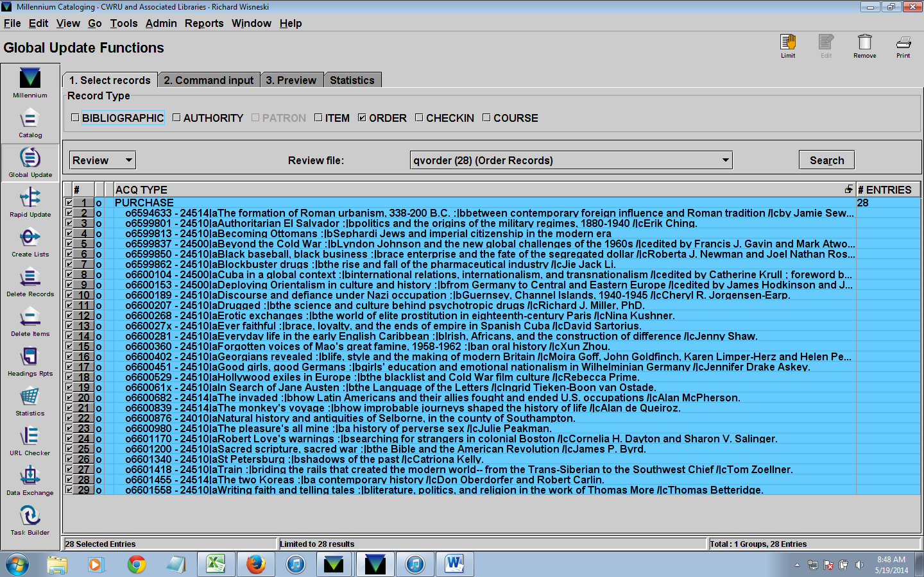
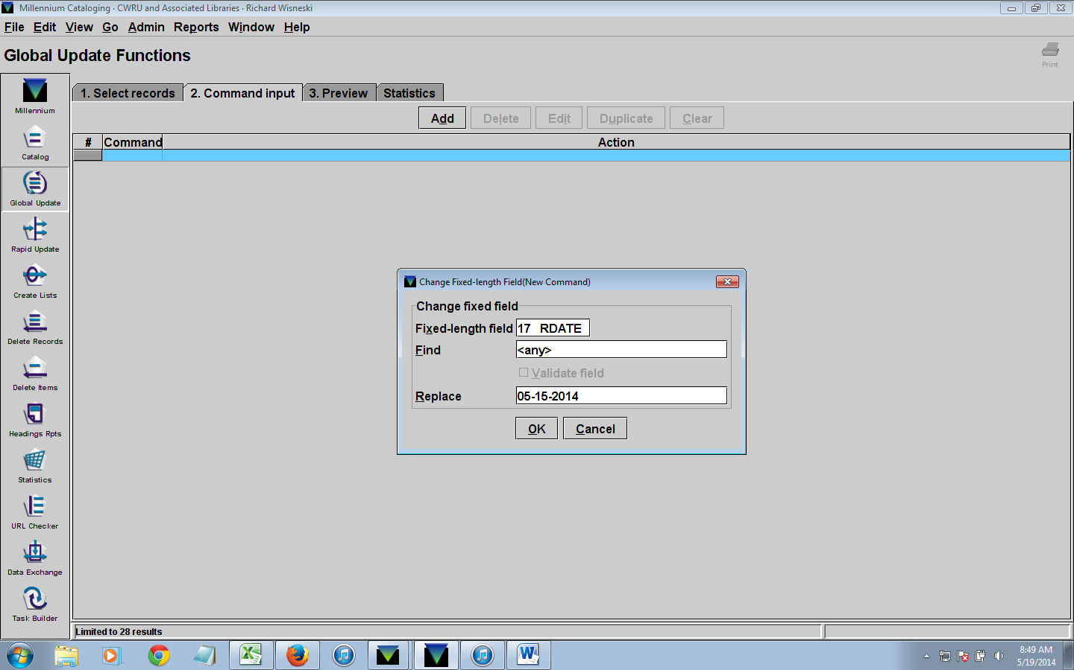
Order Global Update

Slide 14
Global Update on Bibliographic List
In Global Update, clear Command Input and return to first tab
De-select Order and select Bibliographic
pull up your bib review file
Click the "2. command input" tab
Click Add
Change fixed-length field
Fixed-length field: 28 CAT DATE
Find: <any>
Replace: key in today's date (Has to be MM-DD-YYYY, so, for example, 02-09-2014, not 2-9-2014). Click OK
Click Add
Insert variable length field: FIELD GROUP TAG: y
MARC TAG: 951 _ _
DATA: 4-digit year, 2-digit month, your first name (e.g. 201402rich

Slide 15
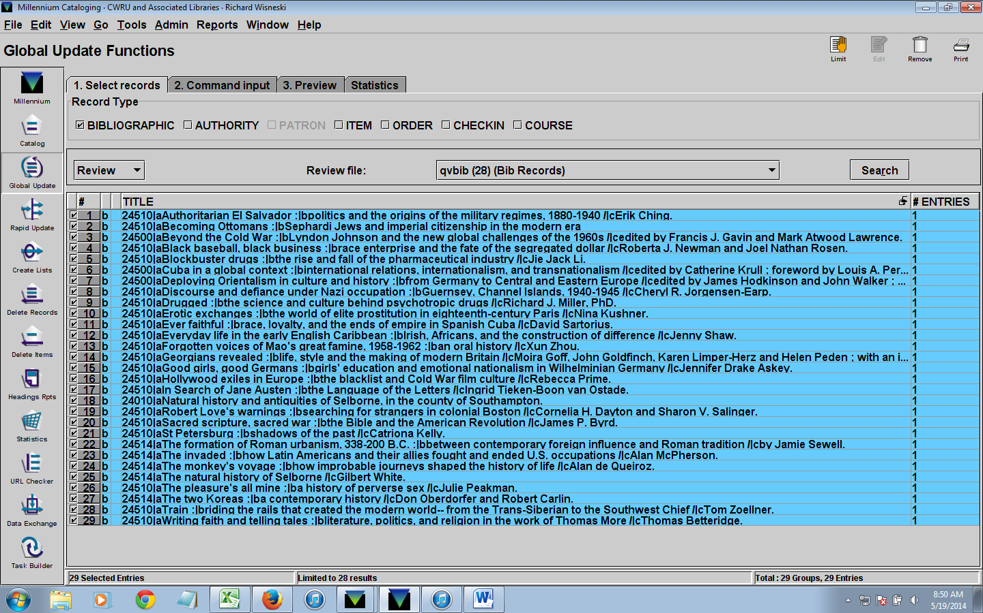
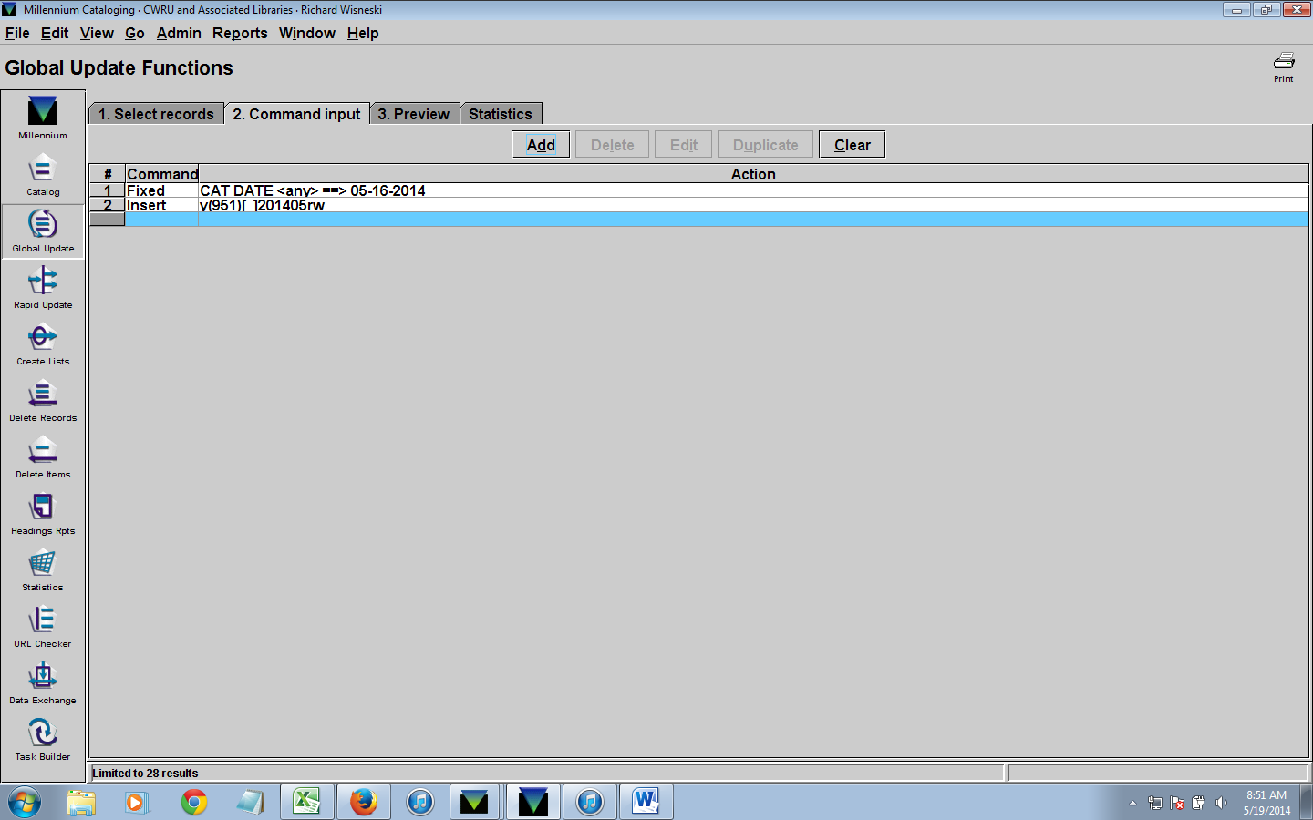
Bibliographic Global Update

Slide 16
Global Update on Item List
In Global Update, clear Command Input and return to first tab
De-select Bibliographic and Select Item. Pull up item file
Create a new command input
Insert variable length field, OK.
De-select "MARC field". Field group tag: x. data; 4-digit year, 2-digit month, your first name (e.g. 201402rich)
Click Add
Select "change fixed-length field"
Fixed-length field: 88 STATUS
Change status to "check shelves"
Click Add
Change fixed field
Fixed-length field: 60 Suppress
Find: <any> replace: - DIS LOC & CENT

Slide 17
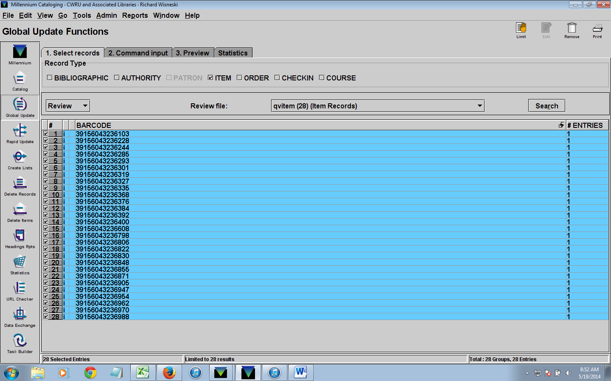
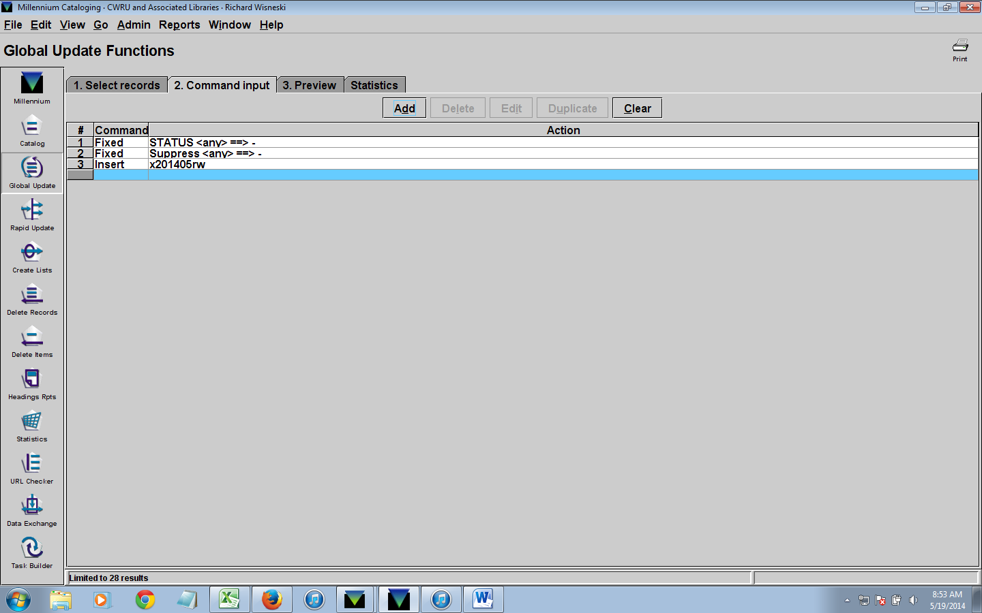
Item Global Update

Slide 18
Conclusion
Review files are emptied
Processed books taken straight to sorting room
Students should have some familiarity with Excel
Copy catalogers and students can both do process
Average length of time to catalog a set of 25 books is one hour

Slide 19
THE END – QUESTIONS?

